Slide 1
Introduction to In-Memory Databases for Analytic Applications
SAP University Alliances
Version SP7
Author Lorraine R. Gardiner, California State University, Chico
This module provides an introduction to the basics of in-memory databases as well as SAP HANA and its use in analytic applications

Slide 2
Agenda
Basic concepts of in-memory databases
SAP HANA overview
SAP NetWeaver BW, SAP NetWeaver BWA and SAP HANA
Analytics on SAP HANA

Slide 3
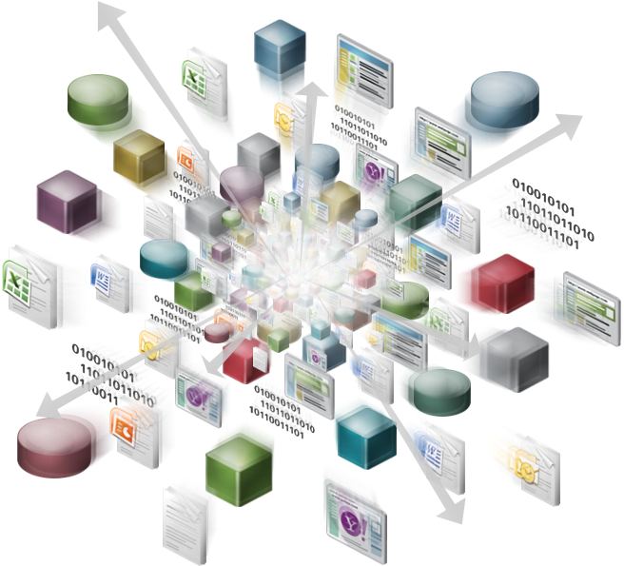
In-Memory Appliance Development
Drivers
Big data
Predictive analytics
Real-time analytics
Self-service BI
Enabling hardware innovations
High-capacity RAM
Multi-core processor architectures
Massive parallel scaling
Massively parallel processing (MPP)
Large symmetric multiprocessors (SMP)
Image Source: Ralokota, R. (May 15, 2011). New tools for new times – primer on big data, Hadoop and “in-memory” data clouds. Retrieved from http://practicalanalytics.wordpress.com/2011/05/15/new-tools-for-new-times-a-primer-on-big-data/
Notes:
In-memory appliances have been developed to enable organizations to leverage information extracted from increasing volumes of data, often in near real time. Recent hardware technology innovations are being utilized to create highly scalable in-memory appliances.
Additional background references:
Bernard, A. (September 20, 2012). How big data brings BI, predictive analytics together. CIO. Retrieved from http://www.cio.com/article/716726/How_Big_Data_Brings_BI_Predictive_Analytics_Together?page=1&taxonomyId=3002
Kulkarni, N. (July 17, 2012). Embrace the future of BI: Self service. Information Management. Retrieved from http://www.information-management.com/newsletters/self-service-business-intelligence-bi-tdwi-kulkarni-10022855-1.html
Kwang, K. (May 12, 2011). In-memory analytics plugs real-time need. ZDNet. Retrieved from http://www.zdnet.com/in-memory-analytics-plugs-real-time-need-2062300307/
Manyika, J., Chui, M., Brown, B., Bughin, J., Dobbs, R., Roxburgh, C., & Byers, A. H. (May 2011). Big data: The next frontier for innovation, competition and productivity. McKinsey Global Institute. Retrieved from http://www.mckinsey.com/insights/mgi/research/technology_and_innovation/big_data_the_next_frontier_for_innovation
Mitchell, R. L. (June 27, 2012). Putting predictive analytics to work. Computerworld. Retrieved from http://www.computerworld.com/s/article/9228230/Putting_predictive_analytics_to_work?taxonomyId=9&pageNumber=2
Mitra, S. (April 13, 2012). SAP HANA – An introduction for the beginners. DWBI Concepts. Retrieved from http://www.dwbiconcepts.com/database/28-hana/98-sap-hana-basics.html
Swoyer, S. (June 5, 2012). Tech talk: Big data meets big density. TDWI. Retrieved from http://tdwi.org/Articles/2012/06/05/Big-Data-Meets-Big-Density.aspx?Page=4&p=1
World Economic Forum (2012). The Global Information Technology Report 2012, Chapter 1.7, 89-96. Retrieved from http://www3.weforum.org/docs/GITR/2012/GITR_Chapter1.7_2012.pdf

Slide 4
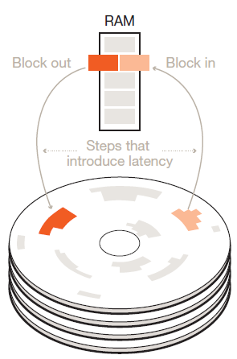
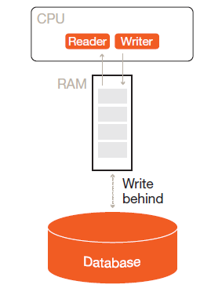
Performance Bottleneck Comparison
Without high-capacity RAM
Database stored on disk
Bottleneck: Latency between disk and RAM
With high-capacity RAM
Database stored in memory
Bottleneck: Latency between CPU and RAM
Orders of magnitude response time improvements
Image Source:Morrison, A. (2012). The art and science of new analytics technology. PwC Technology Forecast, 1, 31-43. Retrieved from http://www.pwc.com/en_US/us/technology-forecast/2012/issue1/features/feature-art-science-analytics-technology.jhtml
Notes:
BI applications have always faced the challenge of satisfactory performance in the face of growing data volumes. In-memory computing reduces latency by removing the bottleneck between disk storage and RAM. The new bottleneck to be optimized is between CPU and RAM. This results in response times that are orders of magnitude faster.

Slide 5
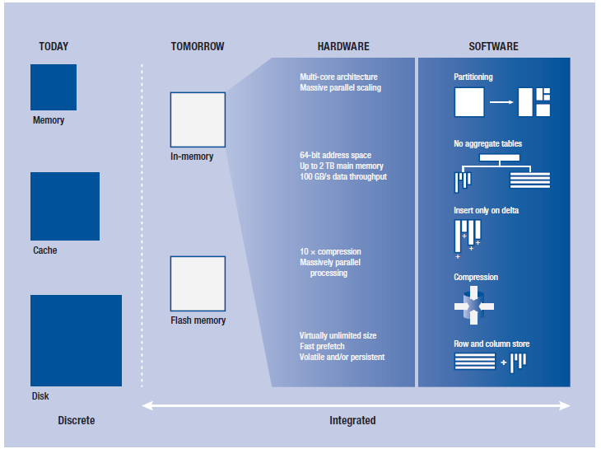
Software That Leverages Hardware Innovations
Source: Plattner, H. & Zeier, A. (2011). In Memory Data Management: An Inflection Point for Enterprise Applications. Retrieved from http://www3.weforum.org/docs/GITR/2012/GITR_Chapter1.7_2012.pdf
Notes:
In-memory appliances deploy software strategies that leverage recent hardware innovations to maximize performance improvements. Primary strategies include compression, columnar database stores and partitioning.
The following references provide clear summaries of how the software strategies facilitate performance improvements.
Mitra, S. (April 13, 2012). SAP HANA – An introduction for the beginners. DWBI Concepts. Retrieved from http://www.dwbiconcepts.com/database/28-hana/98-sap-hana-basics.html
Morrison, A. (2012). The art and science of new analytics technology. PwC Technology Forecast, 1, 31-43. Retrieved from http://www.pwc.com/en_US/us/technology-forecast/2012/issue1/features/feature-art-science-analytics-technology.jhtml
Note: In theory, the resulting response time reductions eliminate the need for aggregate tables. According to HANA consultants attending the first Train the Trainer session in Dresden (September 2012), best practice in HANA data modeling includes the use of extra physical tables in the database to hold data resulting from complex joins instead of views.

Slide 6
Why Columnar Data Storage?
Advantages
Better I/O bandwidth utilization
Higher cache efficiency
Faster data aggregation
High compression rates
Column-based parallel processing
Disadvantages
Load times can be slow
Less efficient for transactional processes
Possibly slower relational interfaces
Notes:
Columnar data storage is particularly helpful for analytic applications due to larger amount of relevant data returned for each I/O trip as well as its higher compression rate and ease of partitioning for parallel processing.
Related References:
Foley, J. (2009). Comparison of data warehousing DBMS platforms. Illuminate. Retrieved from http://www.odbms.org/download/illuminate%20Comparison.pdf
Newland, J. (2008). Data warehouse appliances: Understanding appliance architecture. Datric. Retrieved from http://www.datric.com/docs/DW%20Appliances%20pt1%20-%20Architecture.pdf

Slide 7
Columnar Storage Example
Country | Customer | Product | Sold Pieces
USA | 3000 | DXTR1100 | 5
USA | 4000 | DXTR1100 | 21
Germany | 23000 | DXTR3100 | 12
Germany | 17000 | DXTR3100 | 34
Row table
Column table
Row 1
USA | 3000 | DXTR1100 | 5
Column1
Column2
Column3
Column4
Row 2
USA
USA
Germany
Germany
3000
4000
23000
17000
DXTR1100
DXTR1100
DXTR3100
DXTR3100
5
21
12
34
USA | 4000 | DXTR1100 | 21
Row 3
DE | 23000 | DXTR3100 | 12
Row 4
DE | 17000 | DXTR3100 | 34
Notes:
This example is from taken from SAP HANA Course 1 Chapter 4 (slide 31). The data are from GBI 2.0, an international bike company that serves as the base for a variety of SAP University Alliances curriculum (e.g., SAP ERP, BI).

Slide 8
Agenda
Basic concepts of in-memory databases
SAP HANA overview
SAP NetWeaver BW, SAP NetWeaver BWA and SAP HANA
Analytics on SAP HANA

Slide 9
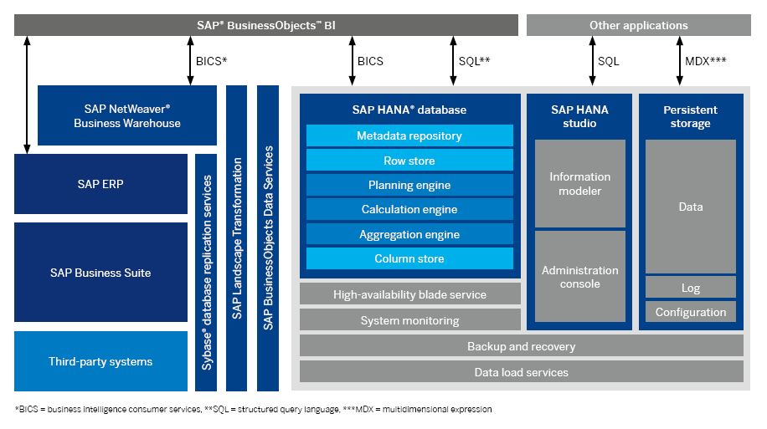
SAP HANA Platform
Source: SAP AG (2012): SAP HANA Technical Overview - Driving Innovations in IT and in Business with In-Memory Computing Technology, p 5
Notes:
*BICS: Business Intelligence Consumer Services
** SQL: Structured Query Language
***MDX: Multidimensional Expressions
Note that the persistency Layer is ONLY needed for disaster recovery so that after a power outage the last version can be restored by utilizing the persistency data (last full backup plus deltas from the log files).

Slide 10

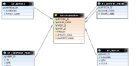
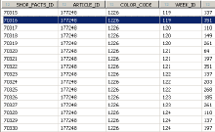
SAP HANA Data Modeling Overview
Front-End
Administration & Data Modeling
SAP HANA Studio
Reporting & Analysis
SAP BusinessObjects Explorer, Crystal Dashboard Design, Crystal Reports, etc...
SAP HANA Database
Views
Tables
Data Provisioning
Trigger-Based Replication
SAP LT Replication Server
ETL-Based Replication
SAP BusinessObjects Data Services
Source Systems
ERP
SCM
Flatfile
DWH
3rd Party
Notes:
Please see Chapter 4 for details on SAP HANA data modeling.

Slide 11
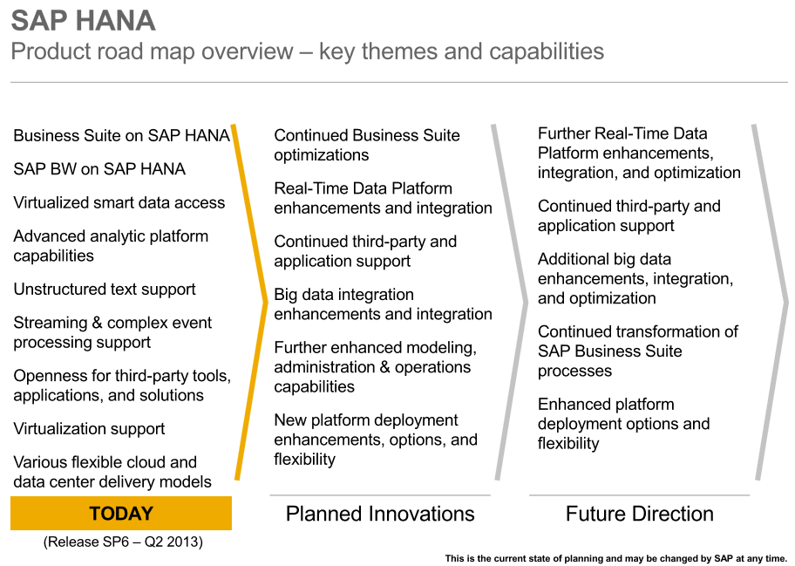
SAP HANA Roadmap
Source: Retrieved from http://www.saphana.com/community/blogs/blog/2013/07/17/here-is-the-sap-hana-roadmap--your-wish-is-our-command
Notes:
Note the medium term plan of SAP Netweaver BW running on SAP HANA as well as SAP Business Suite. SAP HANA is planned to become the DBMS for both analytics and transaction processing.

Slide 12
Solutions Powered by SAP HANA
SAP NetWeaver BW
SAP ERP RDS for Operational Reporting
SAP CO-PA Accelerator
SAP Finance and Controlling Accelerator
SAP Customer Segmentation Accelerator
SAP Sales Pipeline Analysis
SAP Smart Meter Analytics
Charity Transformation (Charitra)
Source: http://www.sap.com/solutions/technology/in-memory-computing-platform/hana/overview/index.epx
Notes:
“Powered by SAP HANA” means applications now capable of running against SAP HANA.

Slide 13
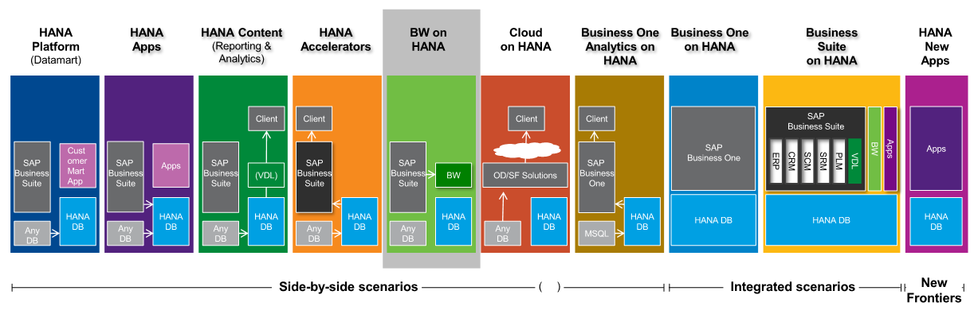
HANA Innovations Overview
Source: Henkes, L. (2012). Increase the speed and efficiency of data processing and analysis with SAP Netweaver BW 7.3 powered by HANA - Overview and roadmap. Retrieved from http://www.experiencesaphana.com/docs/DOC-1522

Slide 14
SAP HANA Success Stories
Berlin Charité – SAP HANA Oncolyzer
Burberry – Customer Analytics on HANA
ConAgra Foods – Business Planning and Consolidation on HANA
John Deere – Real-Time Project Management Reporting
Kraft Foods – SAP BusinessObjects BI 4.0 and SAP HANA
Red Bull – Migration to SAP NetWeaver BW 7.3 on SAP HANA
Notes:
Teaching Suggestion: Assign the reading contained in the slide hyperlinks to students prior to class.

Slide 15
Agenda
Basic concepts of in-memory databases
SAP HANA overview
SAP NetWeaver BW, SAP NetWeaver BWA and SAP HANA
Analytics on SAP HANA

Slide 16
Slow Analytic Application Performance
Users expect quick response times
More data -> slower response
Business value of analytics decreases

Slide 17
Performance Improvement Strategies
SAP NetWeaver BW
InfoCube
Design
Aggregates
Compression
Partitioning
OLAP Cache
MultiProviders
In-Memory Appliances
SAP NetWeaver BW Accelerator (BWA)
SAP HANA
Notes:
A number of strategies exist for maximizing the read performance of InfoCubes in SAP Netweaver BW. These include performance-focused design, aggregates (persistent aggregated subsets of InfoCube data), InfoCube compression and partitioning (both logical and database). In addition to InfoCube performance improvements, OLAP cache is leveraged to speed up the return of query results. Finally, MultiProviders are unions of InfoProviders that allow parallel query processing.
SAP NetWeaver BW Accelerator (BWA) was developed to further improve query performance on large-data InfoCubes.

Slide 18
Performance Improvement Strategies
SAP NetWeaver BW
InfoCube
Design
Aggregates
Compression
Partitioning
OLAP Cache
MultiProviders
In-Memory Appliances
(SAP NetWeaver BWA & SAP HANA)
Columnar storage
In-memory processing
Distributed computing

Slide 19
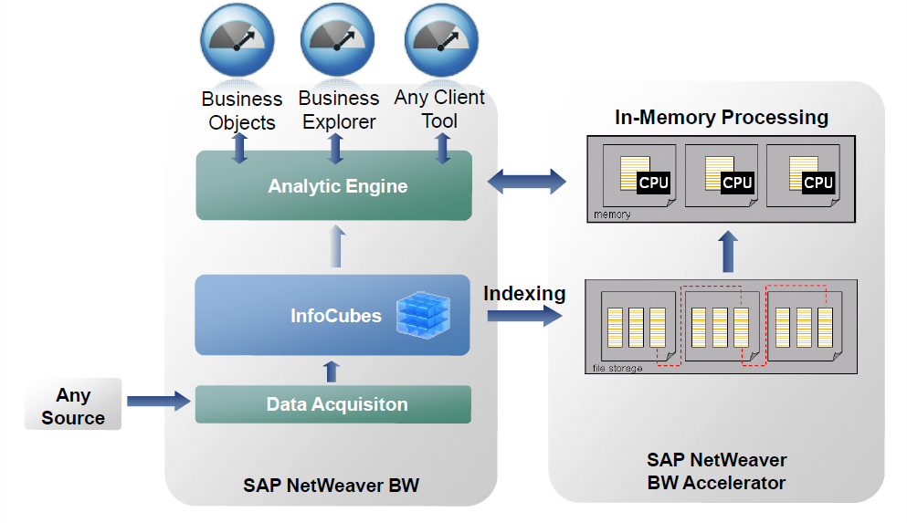
SAP NetWeaver BWA
Loaded for in-memory processing
Indexing, columnar storage & compression
Source: Peter, A. (November 2009). SAP NetWeaver BW Accelerator & SAP BusinessObjects Explorer. Retrieved from http://www.sdn.sap.com/irj/scn/go/portal/prtroot/docs/library/uuid/3604c604-0901-0010-f0aa-b37378495537
Notes:
InfoCube data are replicated to SAP NetWeaver BWA into columnar stores that are indexed and compressed, then loaded into memory to enhance read speed.

Slide 20
SAP NetWeaver BWA & SAP HANA Similarities
Columnar storage
In-memory processing
Distributed computing
Calculation engine

Slide 21
SAP NetWeaver BWA & SAP HANA Differences
SAP NetWeaver BWA
Dedicated to replication of InfoCube data
SAP HANA
Robust data replication
Standard interfaces
Column and row storage
Persistence layer
Analytic plus application database

Slide 22
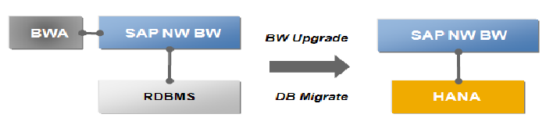
SAP NetWeaver BW on SAP HANA Overview
Source: Henkes, L. (2012). Increase the speed and efficiency of data processing and analysis with SAP Netweaver BW 7.3 powered by HANA - Overview and roadmap. Retrieved from http://www.experiencesaphana.com/docs/DOC-1522

Slide 23
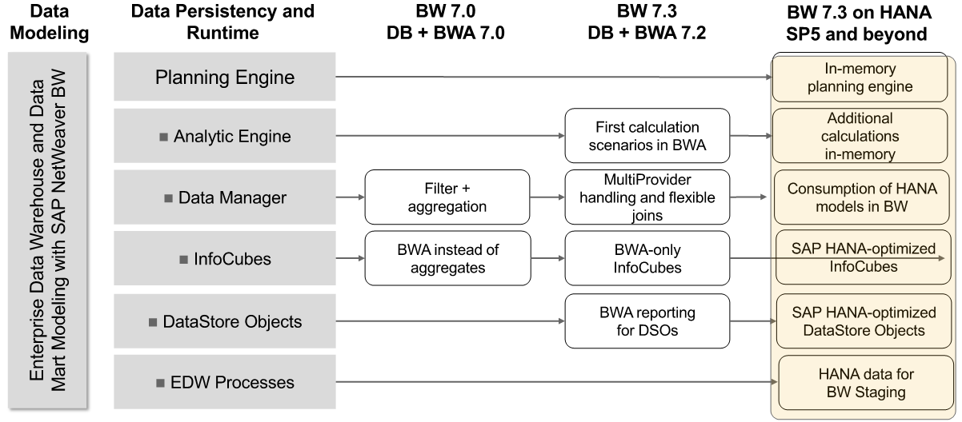
Evolution to SAP NetWeaver BW 7.3 on SAP HANA
Source: Henkes, L. (2012). Increase the speed and efficiency of data processing and analysis with SAP Netweaver BW 7.3 powered by HANA - Overview and roadmap. Retrieved from http://www.experiencesaphana.com/docs/DOC-1522

Slide 24
Agenda
Basic concepts of in-memory databases
SAP HANA overview
SAP NetWeaver BW, SAP NetWeaver BWA and SAP HANA
Analytics on SAP HANA

Slide 25

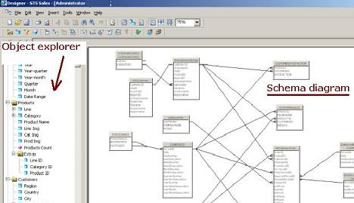
Analytic Application Options
Analytic Applications against
SAP NetWeaver BW InfoProviders
SAP BusinessObjects Universes
SAP HANA Views
SAP HANA Course 1
Notes:
Analytics on SAP HANA views is the focus of SAP HANA first course.
Note: Analytics typically work against SAP HANA views but are not restricted to views as a source.

Slide 26
SAP HANA Data Modeling Overview
Front-End
Administration & Data Modeling
SAP HANA Studio
Reporting & Analysis
SAP BusinessObjects Explorer, Crystal Dashboard Design, Crystal Reports, etc.
SAP HANA Database
Views
Tables
Data Provisioning
Trigger-Based Replication
SAP LT Replication Server
ETL-Based Replication
SAP BusinessObjects Data Services
Source Systems
ERP
SCM
Flatfile
DWH
3rd Party
Notes:
Any of the SAP BusinessObjects analytic applications as well as Excel can be used against data on HANA. The data are typically stored in column-based tables, although row-based storage is also available. Analytic applications access data via views designed to support analysis and reporting that do not physically store data.

Slide 27
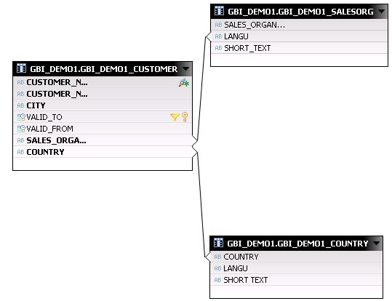
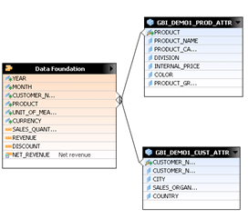
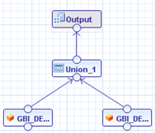
SAP HANA Views for Analytic Applications
Attribute views
Represent master data (attributes, texts, hierarchies)
Provide reusable dimensions for analytic and calculation views
Analytic views
Join facts with relevant attribute dimensions
Calculation views
Address more complex requirements than analytic views
Can include both tables and views
Notes:
All views are logical models and do not physically contain data. See HANA Course 1 – Chapter 4 for more detail on attribute, analytic and calculation views.

Slide 28
References 1/2
Bernard, A. (September 20, 2012). How big data brings BI, predictive analytics together. CIO. Retrieved from http://www.cio.com/article/716726/ How_Big_Data_Brings_BI_Predictive_Analytics_Together?page=1&taxonomyId=3002
Gupta, U. & Kurtz, T. (2011). SAP HANA Overview & Roadmap. Retrieved from http://www.sdn.sap.com/irj/scn/go/portal/prtroot/docs/library/uuid/6015ec1d-7f7d-2e10-06b8-edfa52a4c981?QuickLink=index&overridelayout=true&51342039412472
Foley, J. (2009). Comparison of data warehousing DBMS platforms. Illuminate. Retrieved from http://www.odbms.org/download/illuminate%20Comparison.pdf
Henkes, L. (2012). Increase the speed and efficiency of data processing and analysis with SAP Netweaver BW 7.3 powered by HANA - Overview and roadmap. Retrieved from http://www.experiencesaphana.com/docs/DOC-1522
Kalakota, R. (May 15, 2011). New tools for new times - Primer on big data, Hadoop and "in-memory" data clouds. Retrieved from http://practicalanalytics.wordpress.com/2011/05/15/new-tools-for-new-times-a-primer-on-big-data/
Kulkarni, N. (July 17, 2012). Embrace the future of BI: Self service. Information Management. Retrieved from http://www.information-management.com/newsletters/self-service-business-intelligence-bi-tdwi-kulkarni-10022855-1.html
Kwang, K. (May 12, 2011). In-memory analytics plugs real-time need. ZDNet. Retrieved from http://www.zdnet.com/in-memory-analytics-plugs-real-time-need-2062300307/
Manyika, J., Chui, M., Brown, B., Bughin, J., Dobbs, R., Roxburgh, C., & Byers, A. H. (May 2011). Big data: The next frontier for innovation, competition and productivity. McKinsey Global Institute. Retrieved from http://www.mckinsey.com/insights/mgi/research/ technology_and_innovation/big_data_the_next_frontier_for_innovation
Mitchell, R. L. (June 27, 2012). Putting predictive analytics to work. Computerworld. Retrieved from http://www.computerworld.com/s/article/9228230/ Putting_predictive_analytics_to_work?taxonomyId=9&pageNumber=2

Slide 29
References 2/2
Mitra, S. (April 13, 2012). SAP HANA – An introduction for the beginners. DWBI Concepts. Retrieved from http://www.dwbiconcepts.com/database/28-hana/98-sap-hana-basics.html
Mitra, S. (May 25, 2012). SAP HANA architecture. DWBI Concepts. Retrieved from http://www.dwbiconcepts.com/database/28-hana/105-sap-hana-architecture.html
Morrison, A. (2012). The art and science of new analytics technology. PwC Technology Forecast, 1, 31-43. Retrieved from http://www.pwc.com/en_US/us/technology-forecast/2012/issue1/features/feature-art-science-analytics-technology.jhtml
Newland, J. (2008). Data warehouse appliances: Understanding appliance architecture. Datric. Retrieved from http://www.datric.com/docs/DW%20Appliances%20pt1%20-%20Architecture.pdf
Peter, A. (November 2009). SAP NetWeaver BW Accelerator & SAP BusinessObjects Explorer. Retrieved from http://www.sdn.sap.com/irj/scn/go/portal/prtroot/docs/library/uuid/3604c604-0901-0010-f0aa-b37378495537
Swoyer, S. (June 5, 2012). Tech talk: Big data meets big density. TDWI. Retrieved from http://tdwi.org/Articles/2012/06/05/Big-Data-Meets-Big-Density.aspx?Page=4&p=1
World Economic Forum (2012). The Global Information Technology Report 2012, Chapter 1.7, 89-96. Retrieved from http://www3.weforum.org/docs/GITR/2012/GITR_Chapter1.7_2012.pdf

